Slide 1
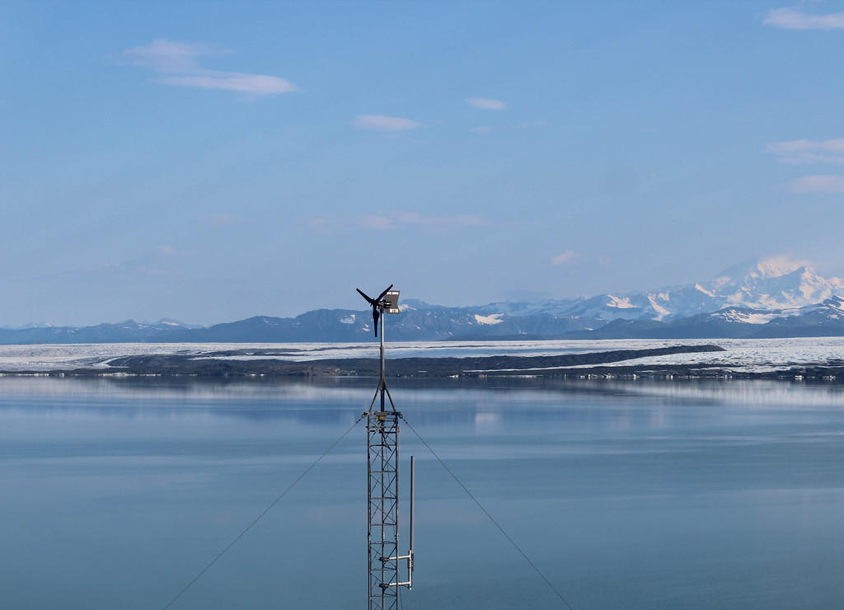

APRS World’s early-2017
Wind Turbine Update
James Jarvis
APRS World, LLC
www.aprsworld.com

Slide 2
History
APRS World was founded in 2006 with focus on designing and manufacturing small wind resource assessment hardware
Resource assessment turned into performance monitoring
Performance monitoring turned into turbine testing for customers
Testing turned into development for customers

Slide 3
APRS World’s
Micro Wind Turbines
WT10 - 1 meter rotor diameter
WT14 – 1.4 meter rotor diameter
Designed and extensively tested for harsh arctic and Antarctic environments
Selling since 2011 and approximately 300 units around the world in
  scientific and industrial applications
  military power systems
Available in 12 / 24 / 48 volt battery charging with various yaw and blade attachment options

Slide 4
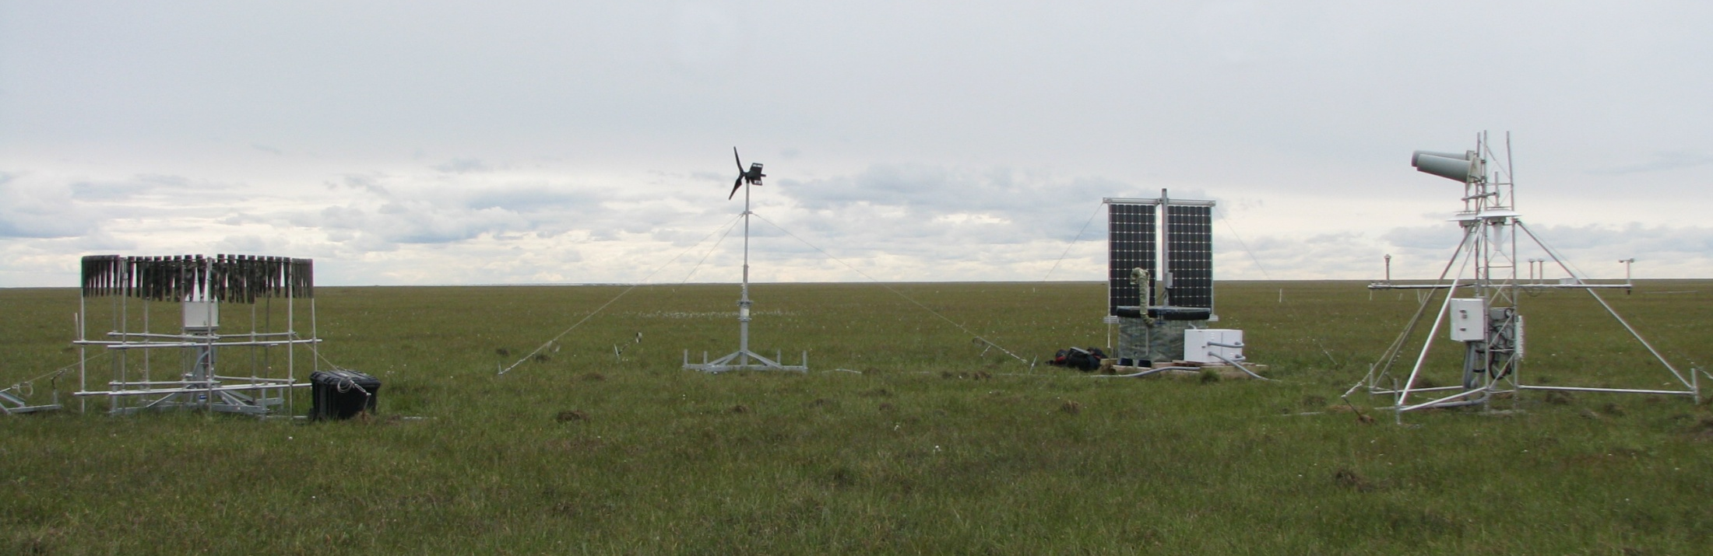
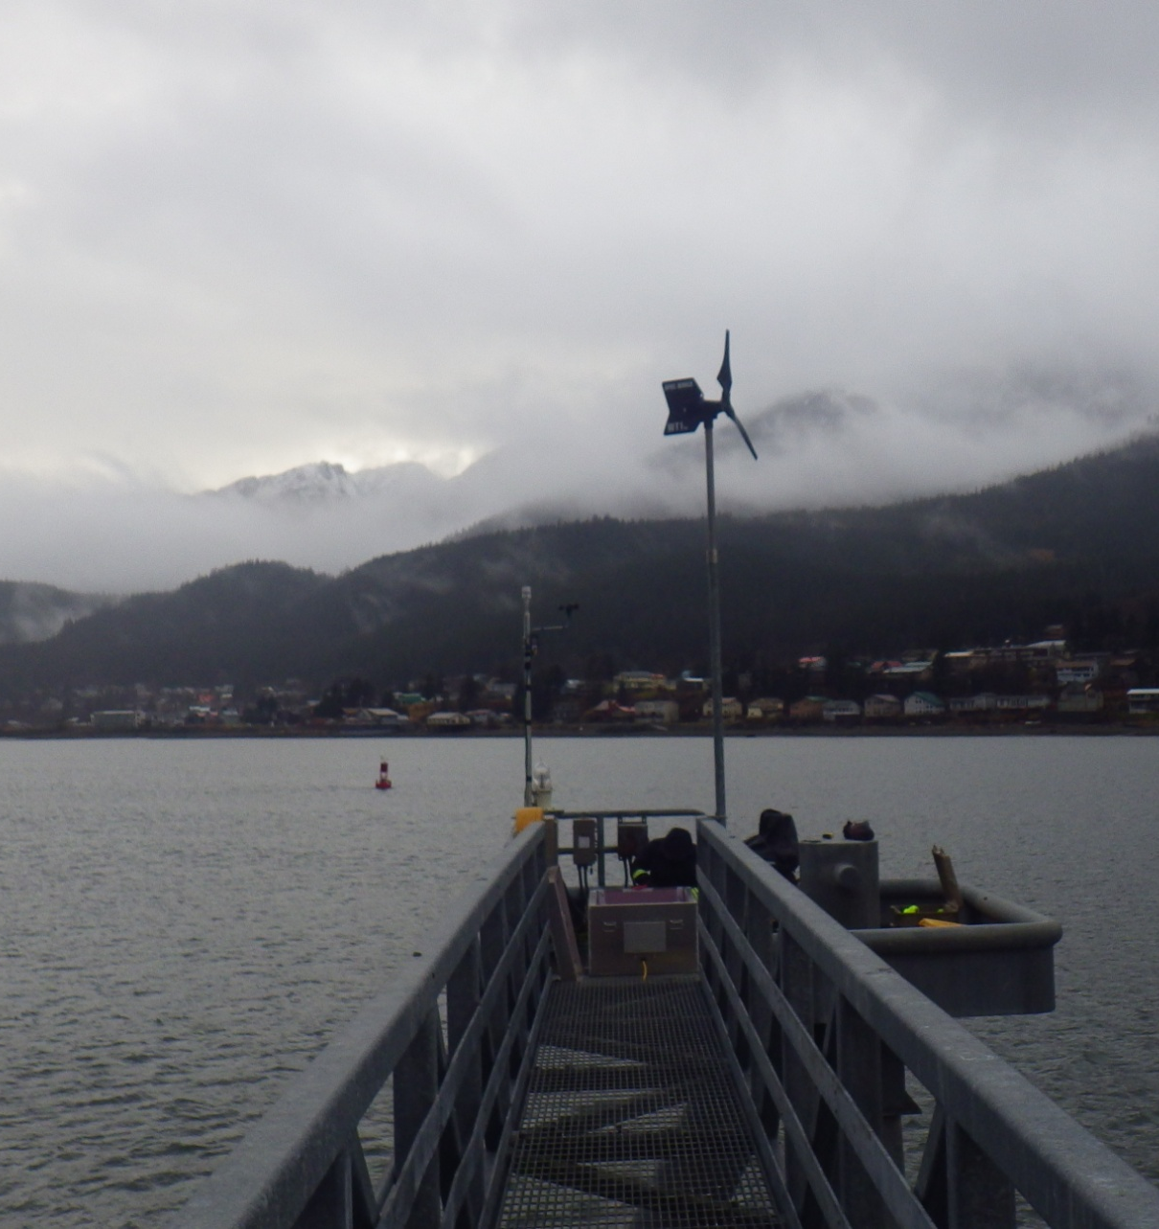
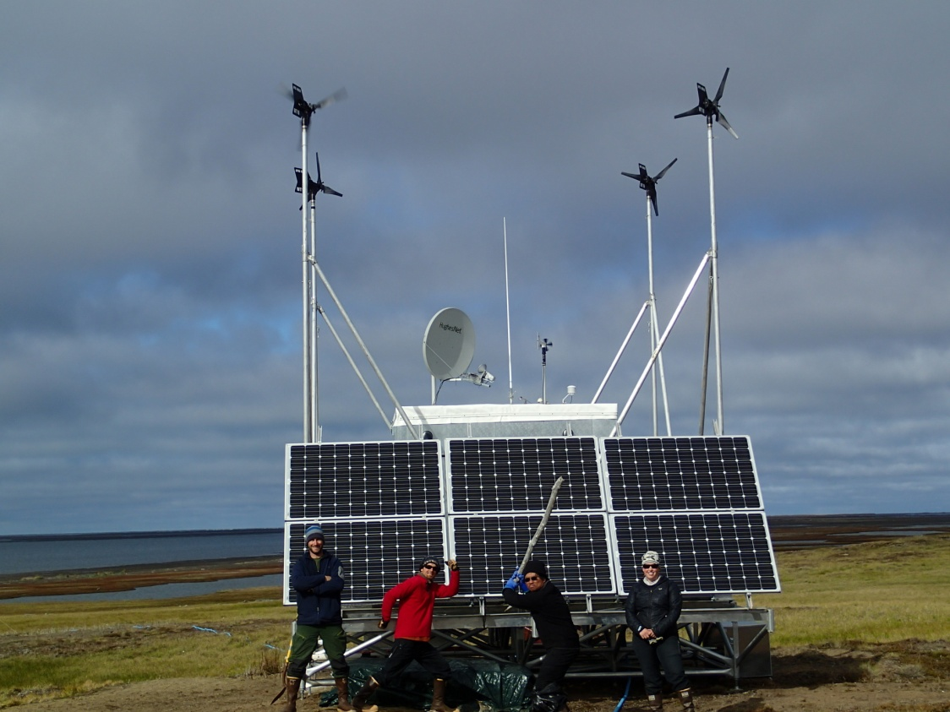
Arctic and sub-Arctic

Slide 5
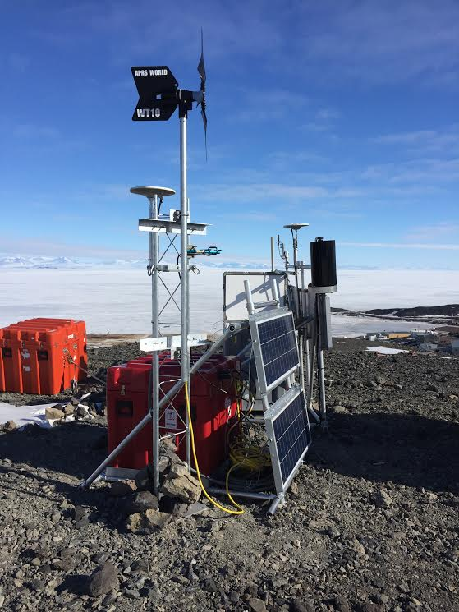
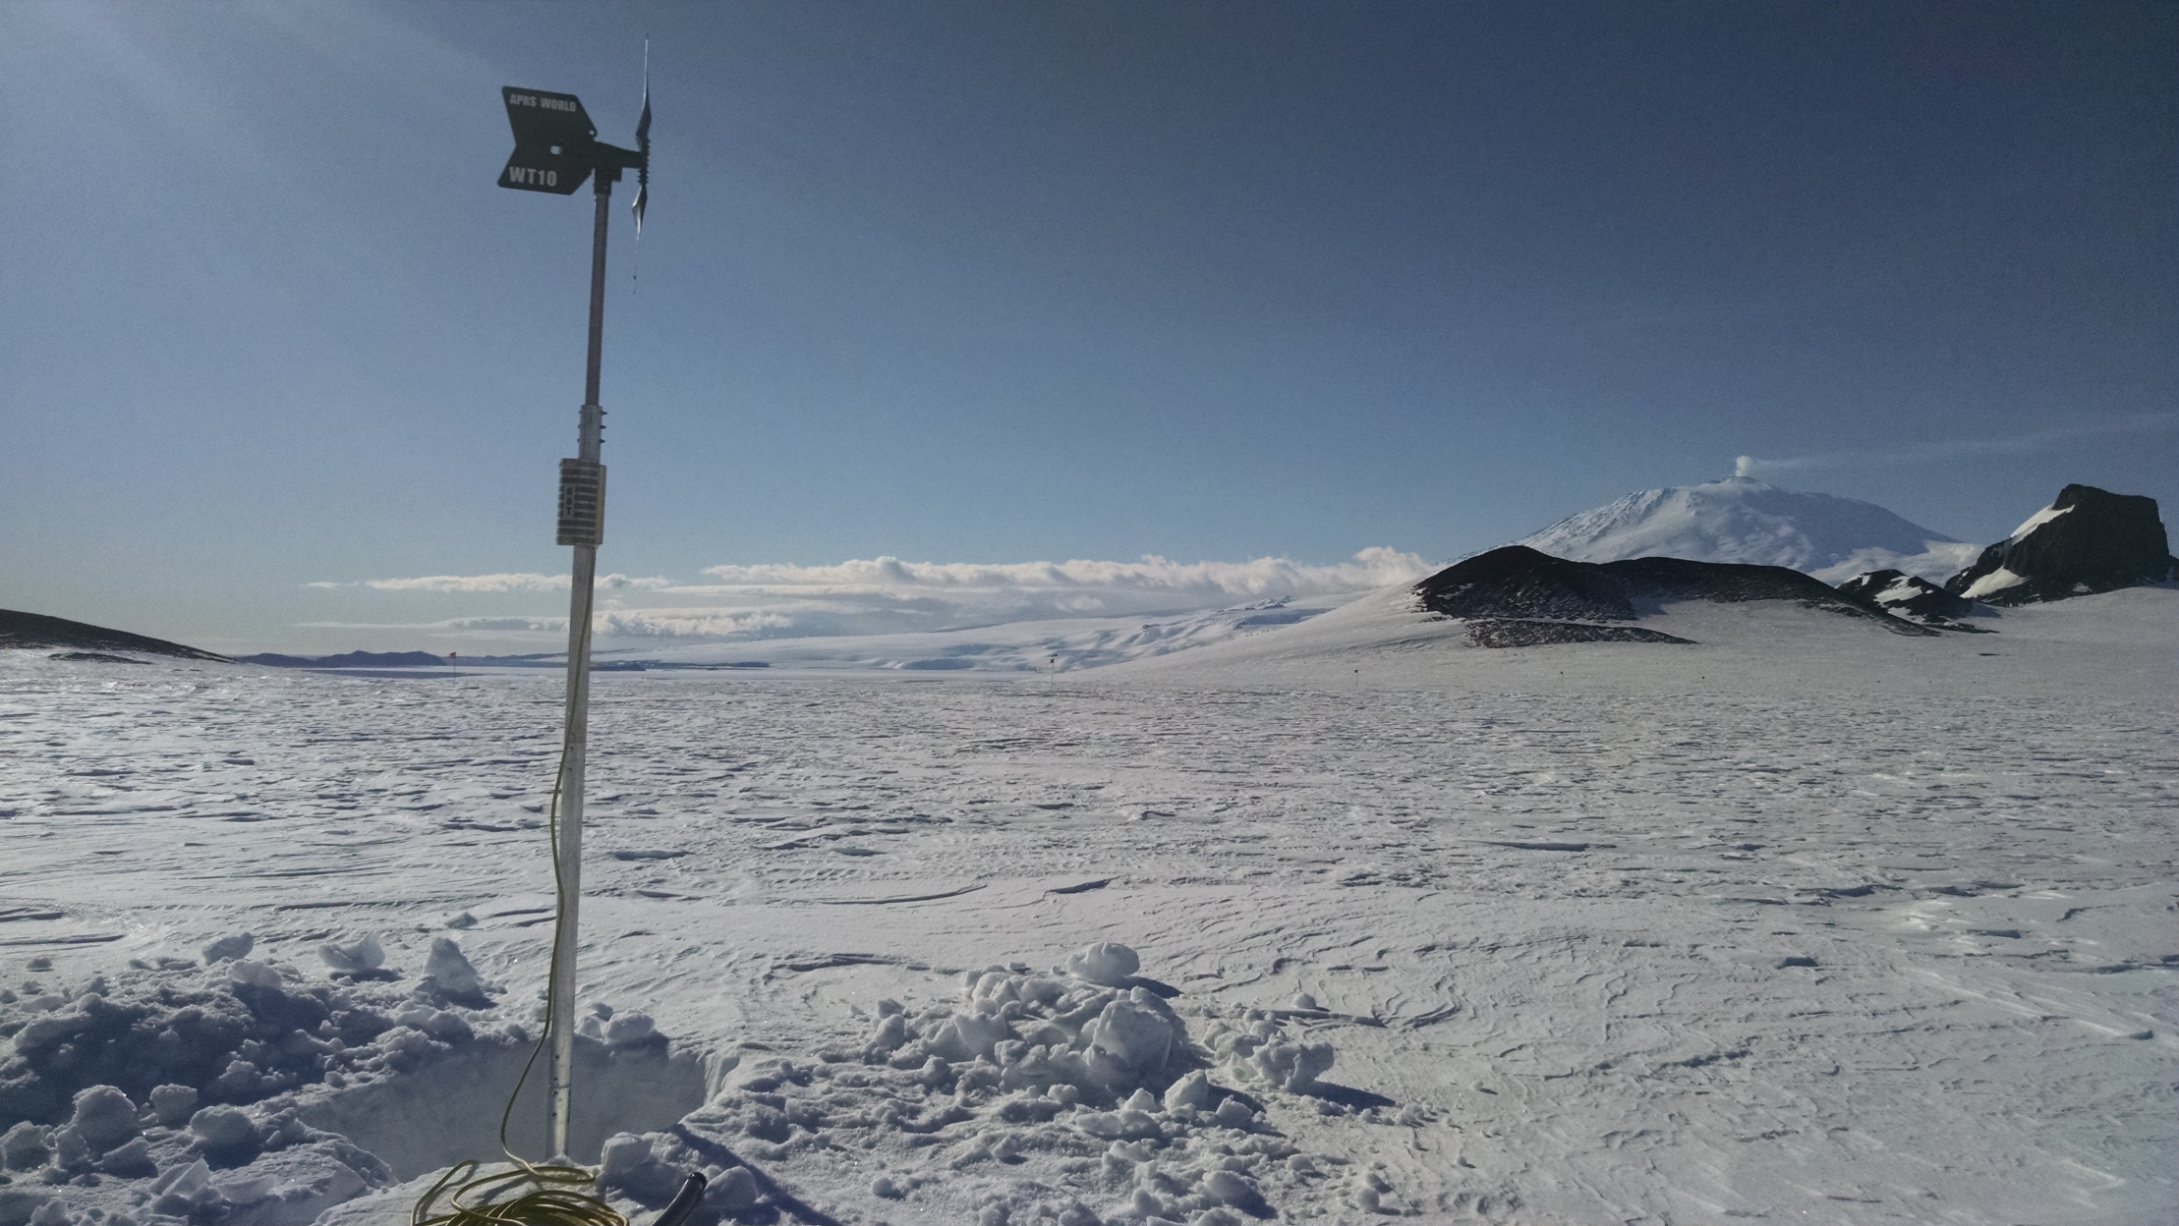
Antarctic

Slide 7
WT1x Field Failures in last year
Turbine on a tiny island off of Kodiak Island, AK shed its tail … but continued to operate
Power system contained in extremely well insulated enclosure overheated and caused lithium battery thermal run-away and presumed site destruction

Slide 8
WT1x Improvements
Tails are now made from stainless steel that won’t cyclically fatigue the same way the aluminum did
New custom turbine controller in development
  self powered with zero consumption from battery
  two integrated dump controls with thermostatic control
  auxiliary output to drive shorting or open circuiting relay
  communications for monitoring and SCADA

Slide 9
APRS World’s
New / Old and Small / Big Turbine
In 2016 we purchased the assets of Black Island Wind Turbines, LLC, the latest purveyor of the HR3 “High Reliability” 3kW turbine
The HR3 is a funky old school turbine, but it has a great track record

Slide 10
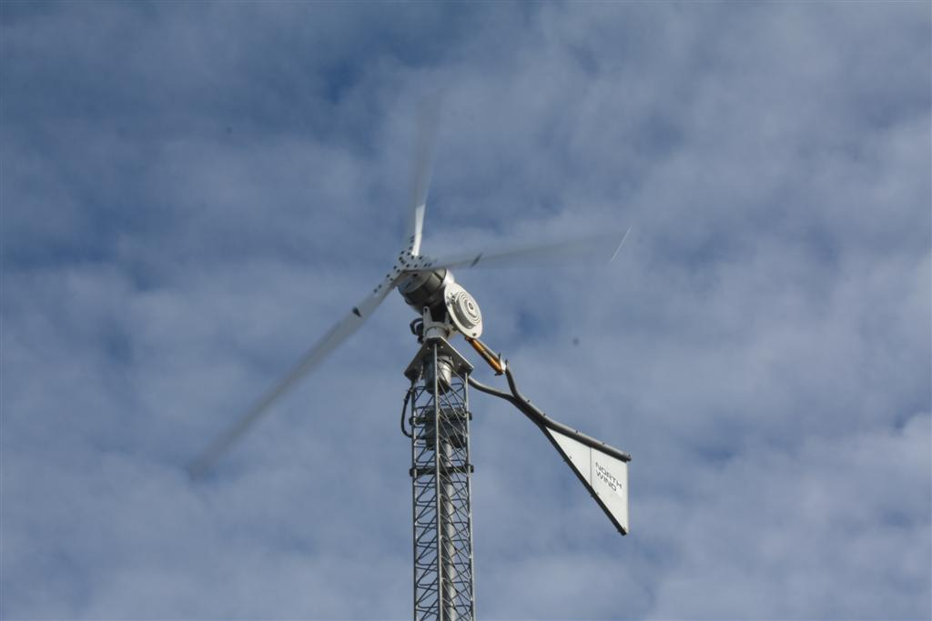

Slide 11
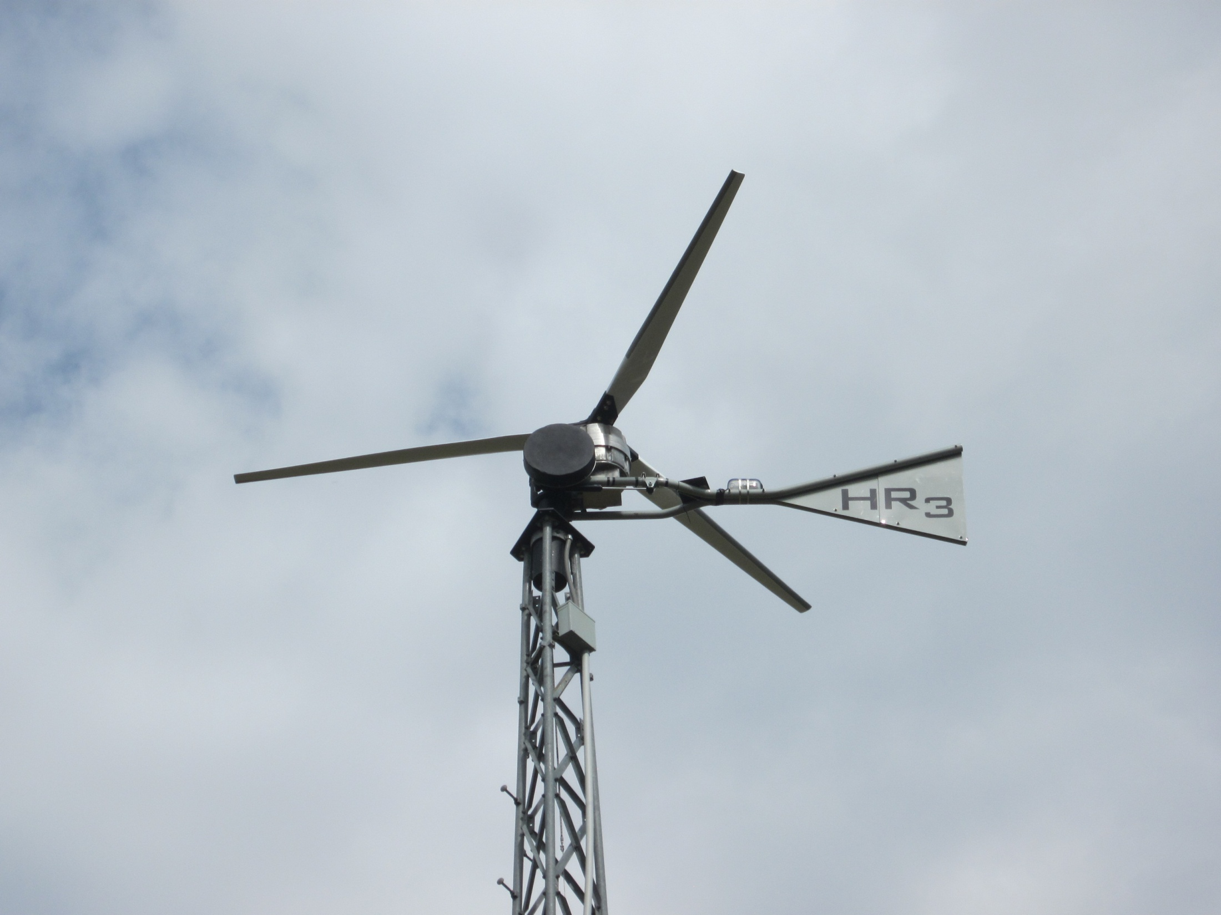

Slide 12
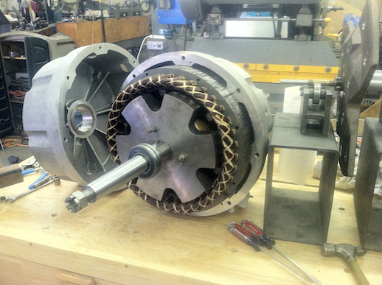

Slide 13
HR2 / HR3 History
Developed in late 1970’s through early 1980’s
  with government contracts and funding
“Hundreds” sold and installed between 1980 and 2000 by “North Wind Power Co” et al
Black Island Wind Turbines LLC acquires property, makes minor improvements, and produces a very small batch of turbines in 2011
  primarily in support of NSF and USAF turbines in operation in Antarctica

Slide 14
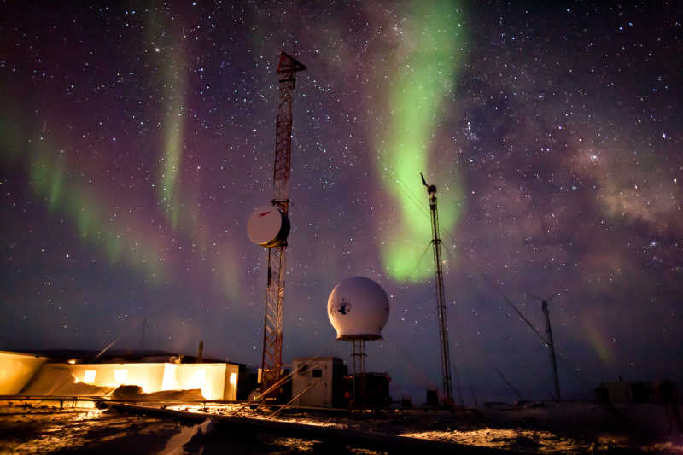

Slide 15
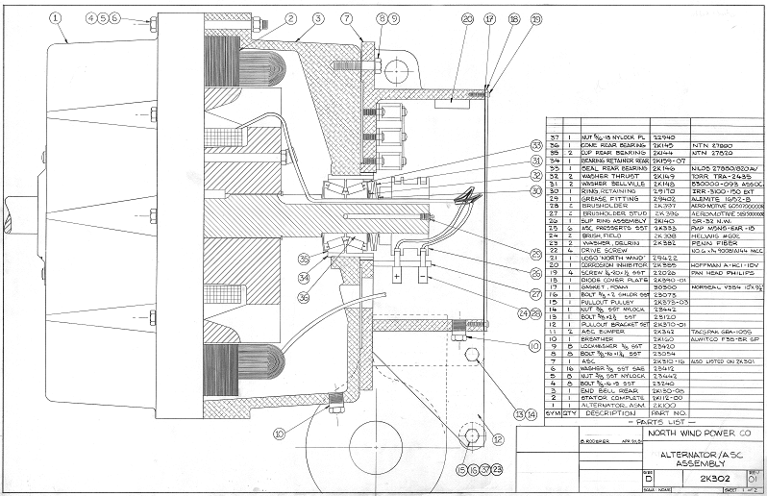

Slide 17
WT1x and HR3 Comparison
 | WT10 | WT14 | HR3
"Rating" | 400 |  | 3,000 | watts
Max Power | 750 |  | 3,000 | watts
Rotor Diameter | 1.0 | 1.4 | 5.2 | meters
Weight | 11 | 12 | 356 | kg
Generator Type | Permanent Magnet |  | Wound Rotor Synchronous
Blade Material | Glass Filled Nylon |  | Laminated Wood
Speed Control | Blade Flutter |  | Passive Pitch (Variable Axis)
Tower, typical | Rohn 25G or 45G |  | Rohn 45GSR
Price, typical | $3,600 |  | $38,750 | USD

Slide 19
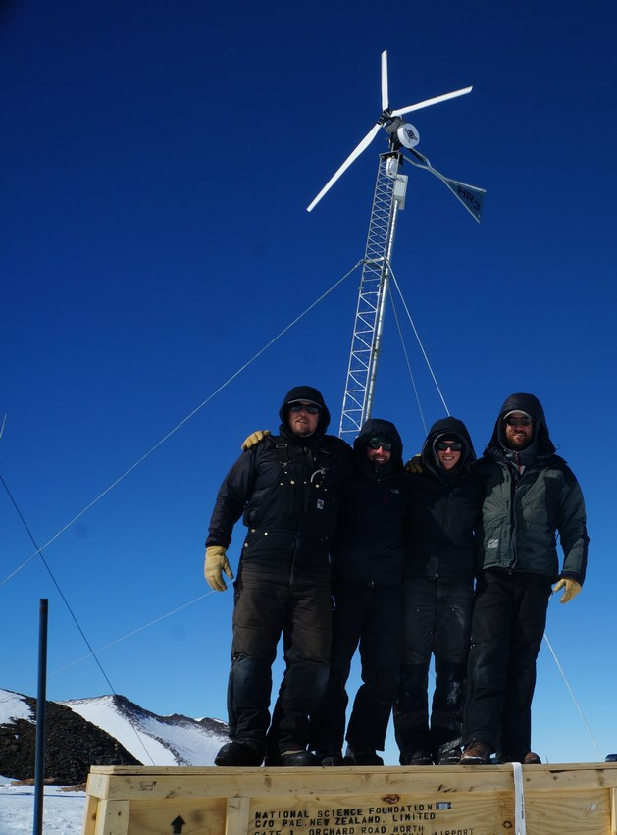
HR3 Compliments to WT1x
Same Locations
  dark windy places
High reliability, well tested, mature
Similar infrastructure requirements
  same size towers
  same site construction equipment
    hand and small helicopter liftable
  similar power output and handling
Customer overlap
Premium product and premium price
  still not for homes

Slide 20
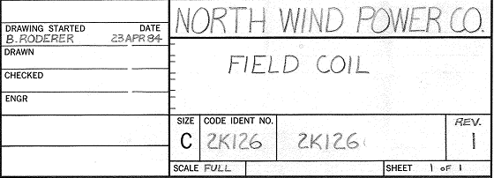
HR3 Divergence from WT1x
Old “tooled” design leads to old manufacturing methods
  cast parts that are very expensive in low volumes
  carved wood blades that are expensive at any volume
  heavy components from pre CAD and FEA days
  near obsolete and single sourced vendor parts
Almost all other APRS World products have been developed in house

Slide 21
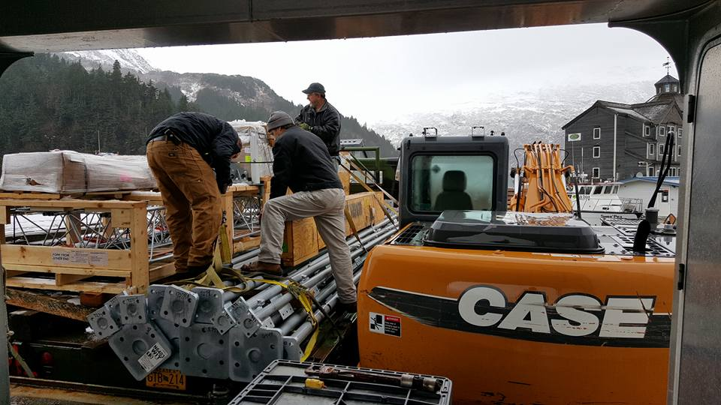
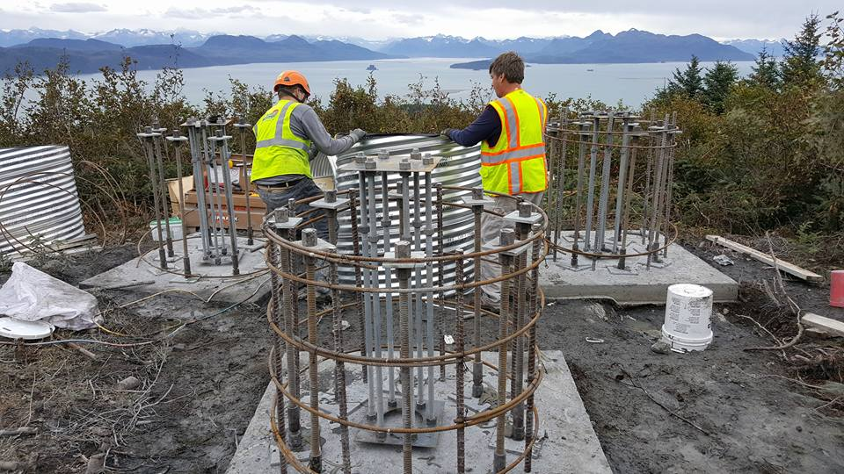
HR3 Plans (the obvious stuff)
Continued service, support, and parts for Northern Power and Black Island Wind Turbines HR3 products
Sales of new HR3A turbines
  “A” designator for APRS World models
Offer APRS World field service and installation for existing HR3 and new HR3A’s world wide

Slide 22
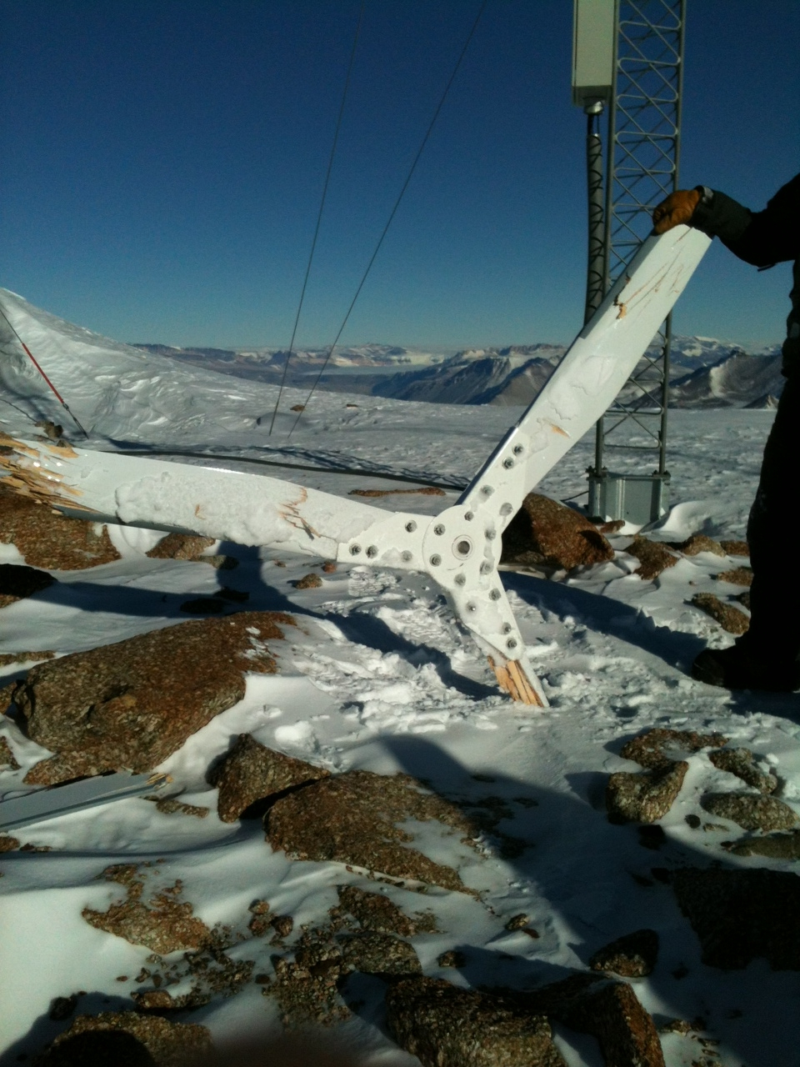
HR3 Plans (the APRS World touch)
Institute continuous improvements to HR3A
  product improvements from customers and field testing
  manufacturing improvements and migration to lower volume manufacturing techniques
Install and operate HR3 and HR3A turbines at our Minnesota and Utah test sites
Be responsive to customers needs and provide complete solutions

Slide 23
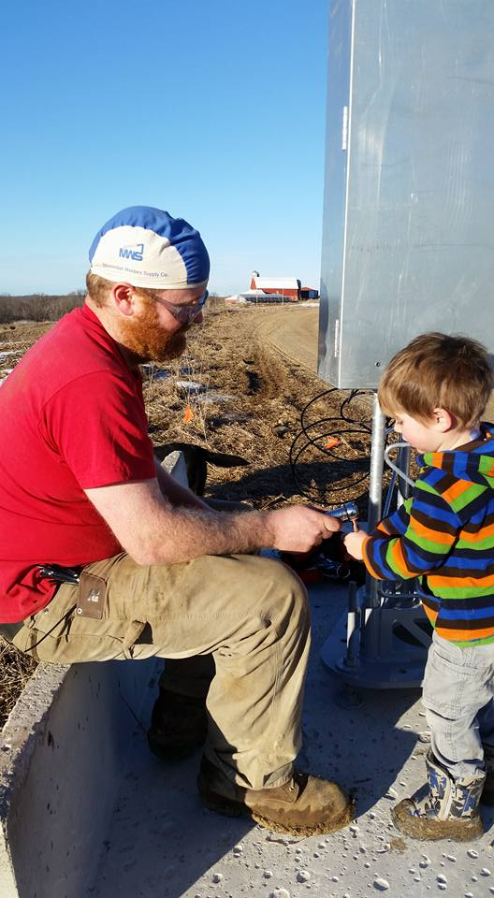
James Jarvis
  APRS World, LLC
  jj@aprsworld.com
  507.454.2727
Information on our products:
http://www.aprsworld.com/

